Slide 1
Computer Basics

Slide 2
Today’s Class
What is a computer
What’s inside the computer
Windows 8.10 Operating System
Computer Mouse
What is the Internet

Slide 4
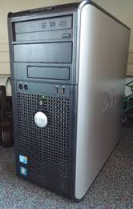
Parts of a Computer
System Unit
Where all the storage and processing is done!

Slide 5
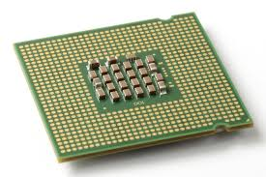
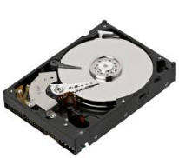
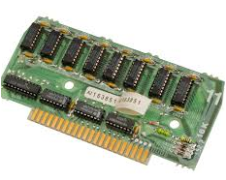
What’s inside the System Unit
CPU
Hard Drive
RAM

Slide 6
What is Inside a Computer?
OR….

Slide 7
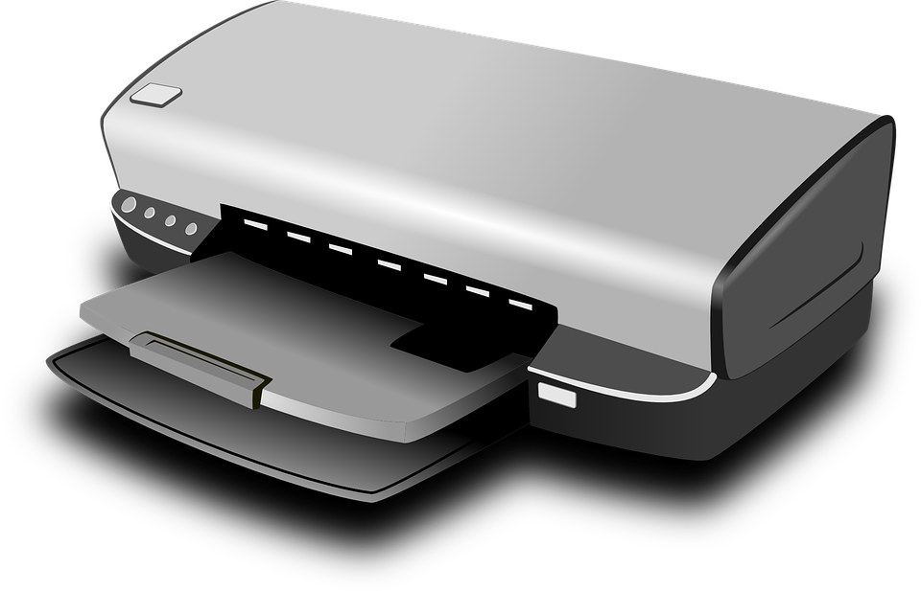
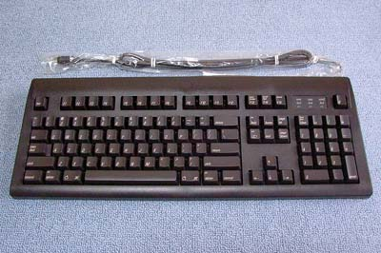
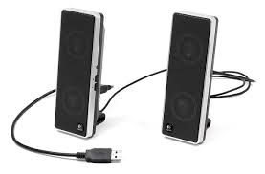
Hardware
Printer
Keyboard
Speakers
Monitor
Mouse

Slide 8
Hardware used for Input
Hardware
We control the Input!
Keyboard
Mouse

Slide 9
Hardware used for Output
Hardware
Printer
The Output is the Processed data!
Speakers
Monitor

Slide 10
Software

Slide 11
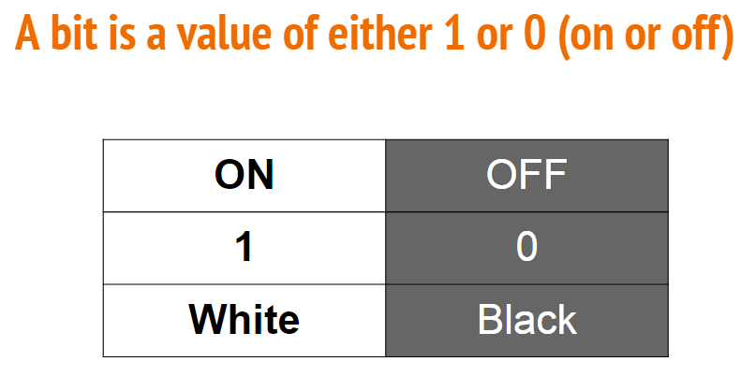
Computers can only read 1’s & 0’s
How do we communicate with a computer?

Slide 12
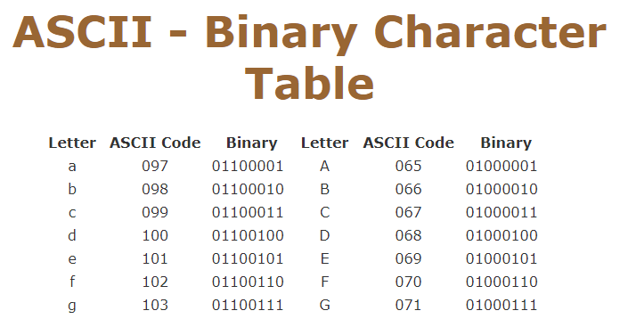

Slide 13
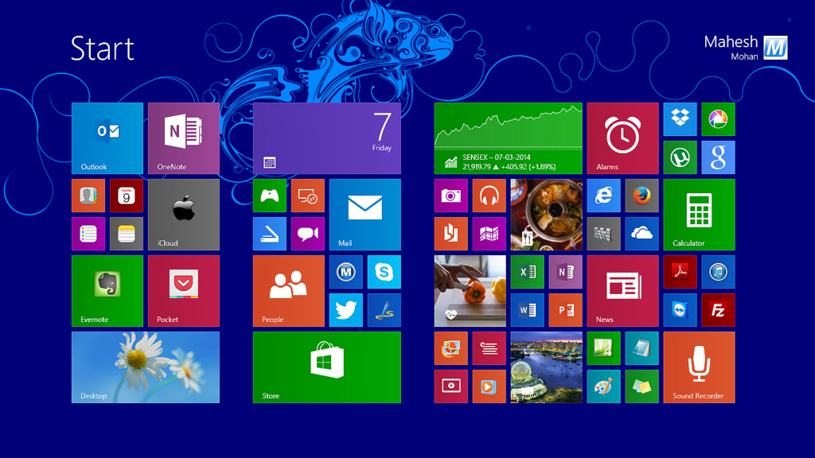
Operating System
Needed to understand 1’s & O’s
Sends software info to the hardware!

Slide 14
Things to consider if purchasing a computer
Desktop vs. Laptop
Mac or PC
Processor speed
Memory
Storage

Slide 16
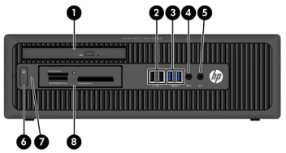
1
2
3
4
5
6
7
8
Inc., H. (n.d.). HP ProDesk 600 G1 Small Form Factor PC - Identifying Components. Retrieved February 06, 2017, from http://h20564.www2.hp.com/hpsc/doc/public/display?docId=emr_na-c03846662

Slide 17
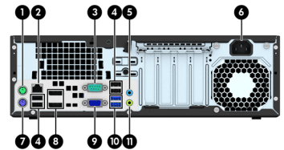
1
2
3
4
5
6
7
4
8
9
10
11
Inc., H. (n.d.). HP ProDesk 600 G1 Small Form Factor PC - Identifying Components. Retrieved February 06, 2017, from http://h20564.www2.hp.com/hpsc/doc/public/display?docId=emr_na-c03846662

Slide 18
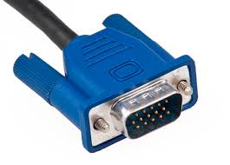
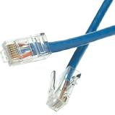
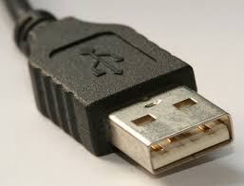
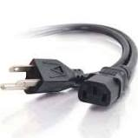
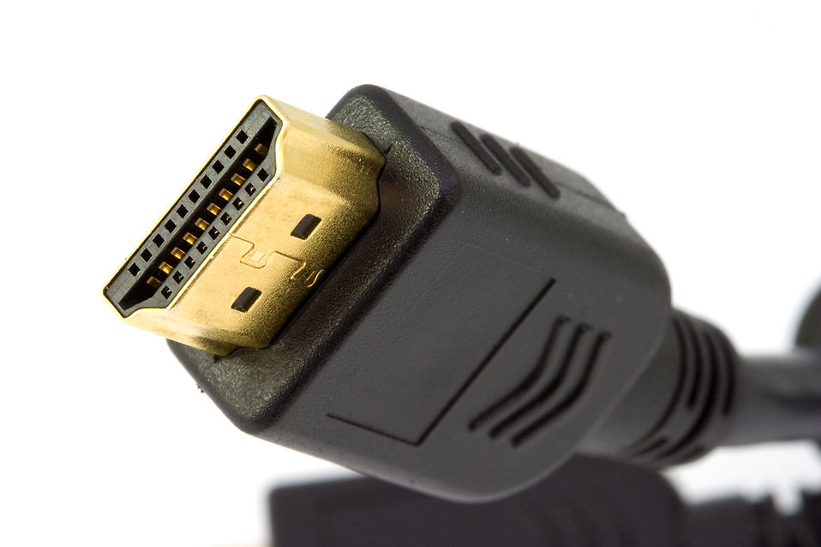
Computer Cables
Ethernet Connector
VGA Cable-Video Graphic Adaptor
Power Cord
USB Cable-Universal Serial Bus
HDMI Cable-High Definition multimedia interface

Slide 19
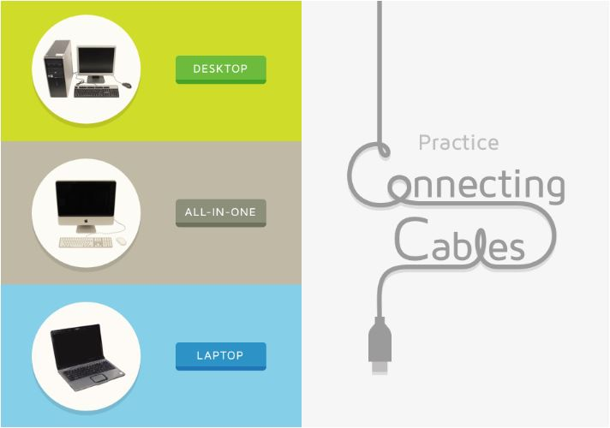
Let’s Connect the cables!

Slide 20
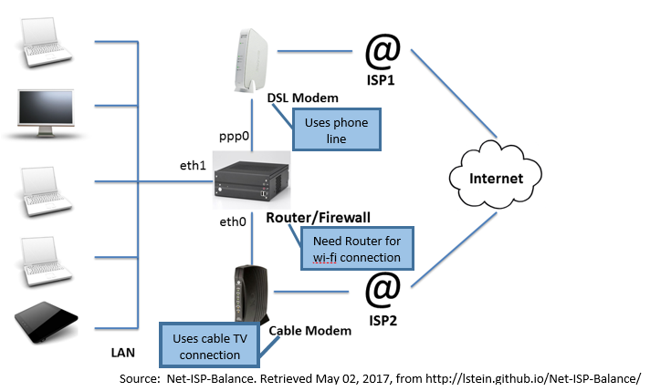
Internet Connection

Slide 21
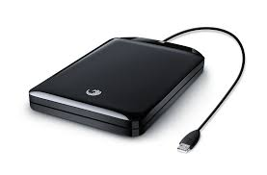
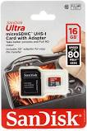
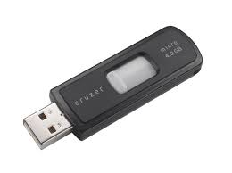
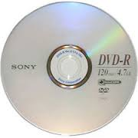
External Storage Devices
VGA Cable
Portable Hard Drive
SD Card
Flash Drive
DVD-R

Slide 22
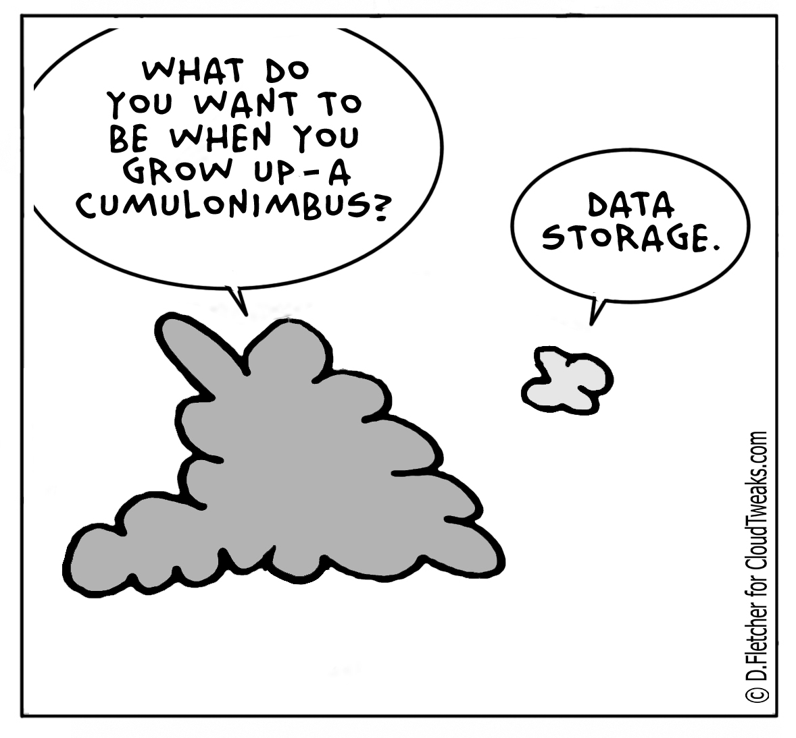
The Cloud?

Slide 23
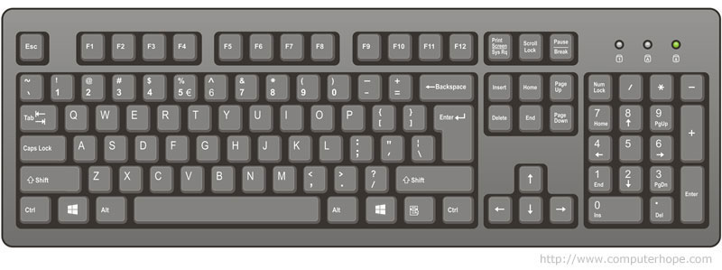
Keyboard Functions

Slide 24
Computer Mouse

Slide 25
LEFT Click
Action!
Action!
Action!
Used most often

Slide 26
RIGHT Click
Options!

Slide 27
Scrolling Wheel
Move up and down.

Slide 28
Computer Mouse Training
GCF Learnfree.org Mouse Tutorial
Jigsaw Puzzle Exercise

Slide 29
The Pointer -- Takes different shapes!
The I-bar
The Arrow
The hand
www.pueblolibrary.org

Slide 30
Single Click vs. Double Click
Single click when selecting in the web browser while on the internet.
Single click when selecting from the window taskbar
Double click on icons on the desktop.
Double click to open files and folders

Slide 31
Mouse
vs.
Mouses
vs.
Mice
Talking about a single mouse: “mouse”
Talking about two or more: “mice” or “mouses”.
Great Tip! Avoid it all together! Call it “mouse devices”.
What is a Computer Mouse? (2017, May 14). Retrieved August 01, 2017, from https://www.computerhope.com/jargon/m/mouse.htm

Slide 32
Navigating the
Windows Interface

Slide 33
Web Browsers

Slide 34
URL
Uniform Resource Locator

Slide 36
Troubleshooting Tips

Slide 37
PROBLEM:
Power Button will not start the computer
Make sure computer is plugged in.
Make sure outlet is working.
Check your surge protector.
Make sure your laptop is charged.

Slide 38
PROBLEM:
Computer is opening slow.
Close and reopen the app.
Check for software updates.

Slide 39
PROBLEM:
Application is frozen.
Ctrl+Alt+Delete -- this will open the Task Manager.
End the task.

Slide 40
PROBLEM:
Mouse or Keyboard stopped working.
Make sure they are plugged in.
If wireless: may need to replace batteries.

Slide 41
PROBLEM:
The screen is blank.
Computer may be sleeping. Move the mouse to wake up.
Make sure monitor is plugged in.
Make sure computer is connected to monitor.

Slide 42
PROBLEM:
Computer will not load program or upload document.
Try a different browser.

Slide 43
Still can’t find a solution?
Try a Google Search

Slide 44
If all else fails...
Restart Computer

Slide 45
Want to learn more?
Lynda.com (PCCLD database)
denverlibrary.org--Denver Public Library Technology Classes
GCF Learnfree.org

Slide 46
How to Use the Mouse

